Slide 1

Unit 2 Let’s talk teens
Integrated skills (Ⅰ)

Slide 2

Free talk
Did you ever have problems with your parents? How did you deal with them?
Did your friends ever complain about their relationship with their parents? What advice did you give to them?

Slide 3

Task 1 Read and summarize
Read the first email of Part A
and try to summarize its
main idea in one sentence.
Rebecca’s problem:
______________________________
She wants her mother to pay less attention to her grades.

Slide 4
Steps for summarizing
Step 1:
Read the paragraph once without highlighting or circling any of its text. This will give you a general idea of the subject and the author’s purpose without getting too caught up in details and descriptions. Pay attention to the author’s purpose for writing the paragraph.

Slide 5
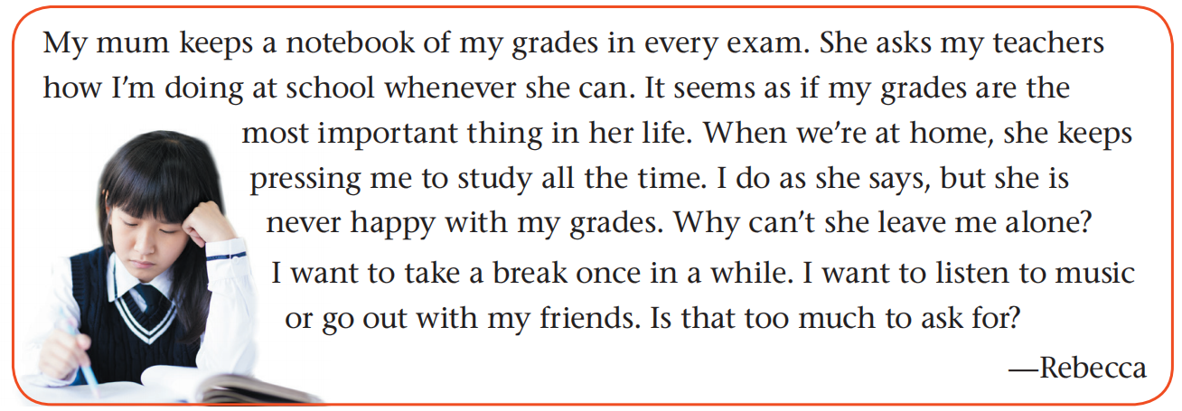
Steps for summarizing
Step 2:
Re-read the paragraph while looking for key words and phrases, usually the words or phrases the author repeats.

Slide 6
Steps for summarizing
Step 3:
Underline the paragraph’s first sentence, which often contains the paragraph’s main idea.
Step 4:
Write one sentence in your words, by connecting the key words you have circled. Avoid adding information or opinions that are not in the original paragraph.

Slide 7
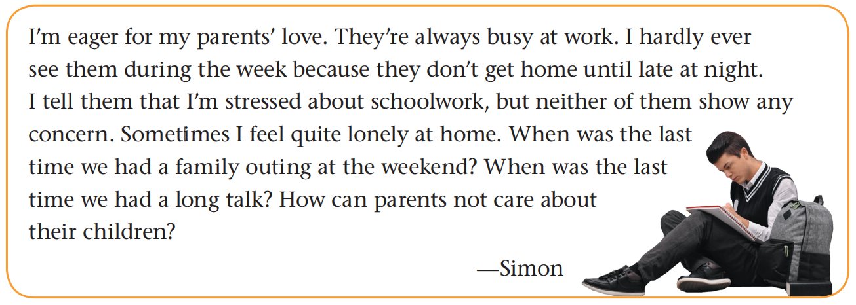
Task 2 Practise and discuss
Simon’s problem:
_______________________________________________
_______________________________________________
He feels lonely because his parents do not spend much time with him.

Slide 8
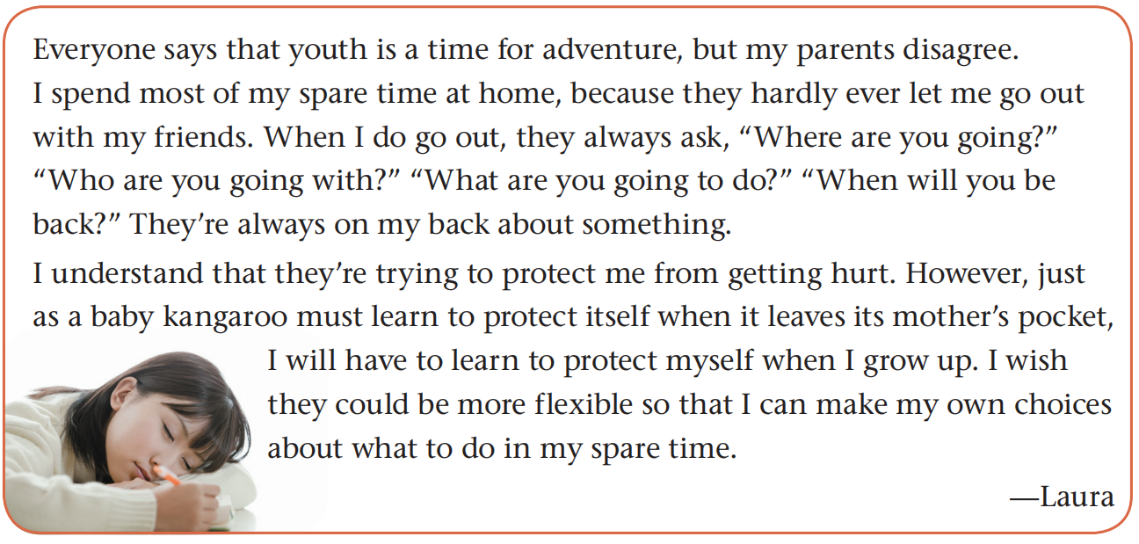
Laura’s problem: ________________________________
Her parents protect her too much.

Slide 9
Task 3 Discuss and share
Rebecca’s problem: She wants her mother to pay less attention to her grades.
Simon’s problem: He feels lonely because his parents do not spend much time with him.
Laura’s problem: Her parents protect her too much.
Questions
1. Which problem is the most difficult one to deal with? Why?
2. Did you have any suggestions to Rebecca?

Slide 10
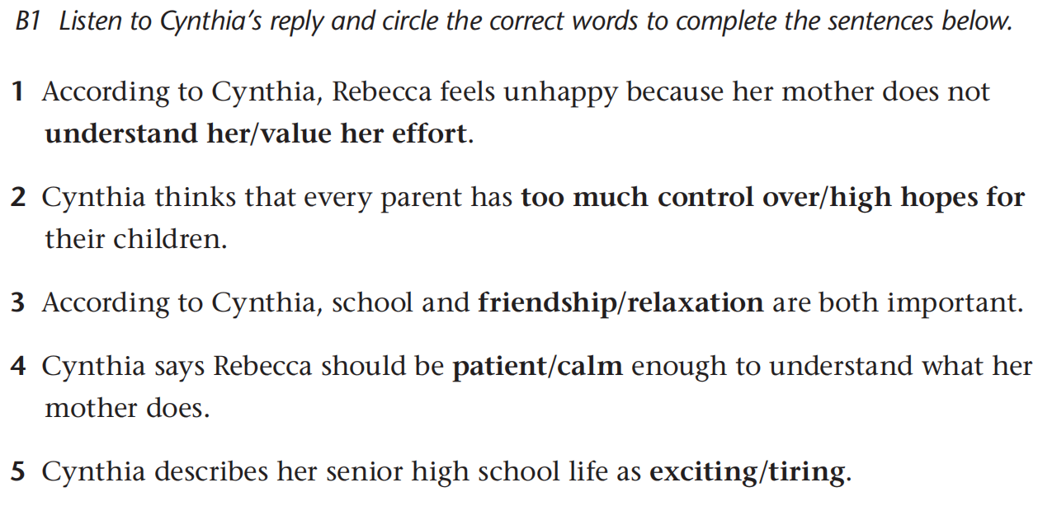
Task 4 Underline and predict

Slide 11
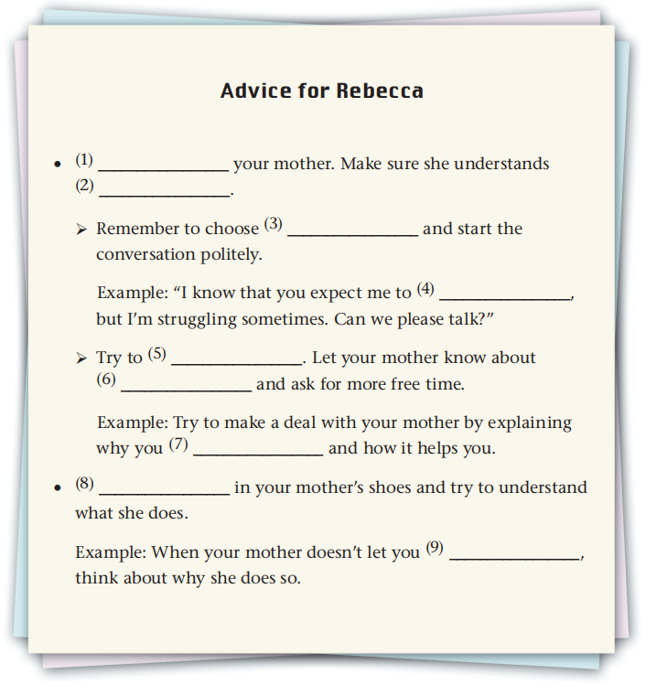

Slide 12
What are probably the advice?
⁽¹⁾ ________ you mother. Make sure she understands ⁽²⁾ ________.
start the conversation politely
let your mother know ... and ask for more free time
⁽⁸⁾ ________ in your mother’s shoes and try to understand what she does.
try to understand what she does
think about why she does so

Slide 13
Task 5 Listen and check

Slide 14
Talking to
your feelings
a good time
do well at school
meet in the middle
your interests
enjoy music
Put yourself
go out with
your friends

Slide 15
Task 6 Group work
Problems
Advice
press sb too much
push sb too far
be hard on sb
be strict with sb
make yourself understood
talk to them
communicate with them
exchange ideas
show no concern
neglect/ignore
be indifferent to sb
not care for
understand your parents
try to meet in the middle
put yourself in your parents’ shoes
be independent of sb
do sth on your own
protect sb against sth
spoil sb
be overprotective

Slide 16
Task 7 Homework
Search on the Internet for more expressions of asking advice and giving advice.
Notes:
此页根据教案所加，如果不需要可以删除

Slide 17


